Slide 1

Seed Sync
Seed Sync is a mobile application designed to revolutionize the agricultural supply chain by connecting farmers directly with consumers and retailers. Our platform aims to eliminate intermediaries, increase transparency, and empower both producers and consumers.
Team Name : Sudo_Seed

Slide 2
Content
Problem Statement
1
The current agricultural supply chain is inefficient and opaque, leading to price volatility and a lack of transparency for both farmers and consumers.
2
Proposed Solution
Seed Sync aims to create a platform that empowers farmers to directly market their products, allowing them to receive fair prices and connect with a wider customer base.
Technology Stack
3
We plan to leverage modern technologies such as mobile application development, geolocation services, and secure payment gateways.
4
Feasibility and Viability
The market for direct-to-consumer agriculture is growing rapidly, and Seed Sync has the potential to become a leading platform in this space.
Challenges
5
Challenges include onboarding farmers, building a user base, and managing logistics and distribution.
6
Impact and Benefits
Seed Sync will create a more equitable and sustainable agricultural ecosystem, benefiting farmers, consumers, and the environment.

Slide 3

Problem Statement
Price Volatility
Lack of Transparency
Intermediaries often exploit farmers by paying them low prices while charging inflated prices to consumers, creating a lack of transparency in the supply chain.
Farmers often face unpredictable market prices, resulting in financial instability and difficulty in planning for the future.
Limited Market Access
Farmers have limited access to larger markets and often rely on local buyers, restricting their ability to reach a wider customer base and diversify their income.

Slide 4




Proposed Solution
Direct Market Access
Seed Sync will allow farmers to directly sell their produce to consumers and retailers, bypassing intermediaries and eliminating price markups.
Transparency and Traceability
The platform will provide real-time information on market prices, product origin, and supply chain details, ensuring transparency and traceability for all stakeholders.
Community Building
Seed Sync will facilitate communication and collaboration between farmers, consumers, and retailers, fostering a sense of community and supporting sustainable practices.

Slide 5

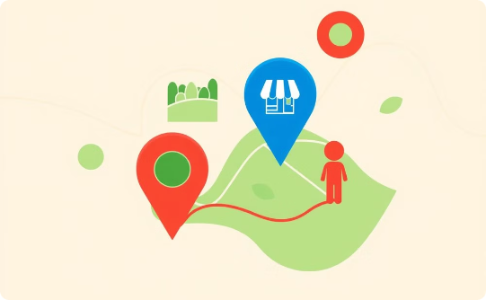

Technology Stack
Mobile Application
Geolocation Services
Payment Gateway
Seed Sync will be a user-friendly mobile application available for both Android and iOS platforms.
The app will utilize GPS and location-based services to connect farmers with nearby consumers and retailers.
Seed Sync will integrate with secure payment gateways to facilitate online transactions between farmers and buyers.

Slide 6
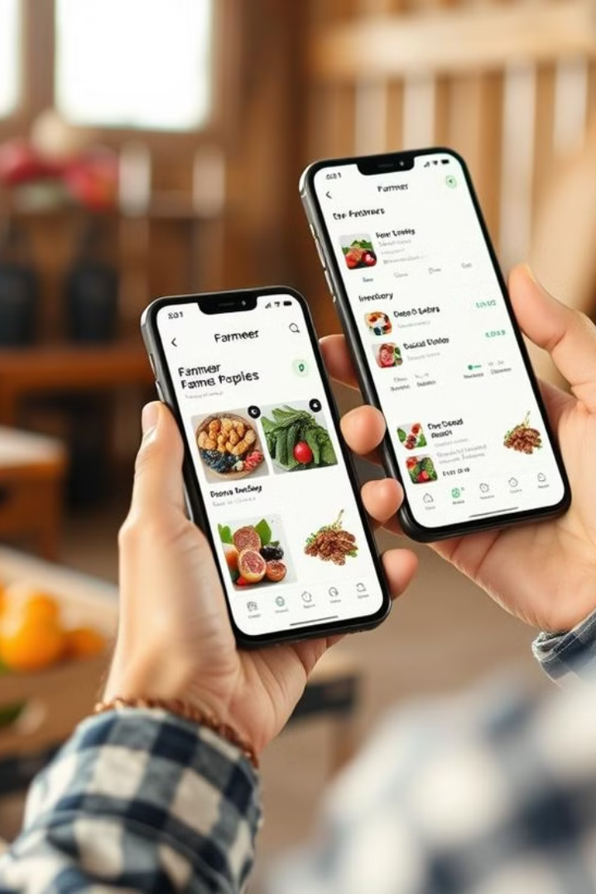
Feasibility and Viability
1
Growing Demand
The demand for direct-to-consumer agriculture is increasing as consumers seek fresh, locally sourced products and greater transparency in the food system.
2
Market Opportunity
Seed Sync can capitalize on this growing market by providing a user-friendly platform that connects farmers with a large customer base.
3
Economic Benefits
The platform can help farmers increase their income by eliminating intermediaries and accessing new markets, while also promoting sustainable practices.

Slide 7

Challenges
Farmer Onboarding
Educating farmers about the platform and its benefits, ensuring ease of use and providing adequate support.
User Acquisition
Building a strong user base by effectively marketing the app to both farmers and consumers.
Logistics and Distribution
Managing the logistics of product delivery, ensuring timely and efficient distribution, and addressing potential logistical challenges.

Slide 8





Impact and Benefits
Increased Farmer Income
Improved Consumer Experience
Farmers can earn more by selling their produce directly to consumers and retailers, eliminating intermediaries and receiving fair prices.
Consumers can access fresh, high-quality produce from local farmers while supporting sustainable agriculture and community development.
Environmental Sustainability
Community Empowerment
The platform promotes local sourcing, reduces food waste, and encourages sustainable farming practices.
Seed Sync fosters a sense of community by connecting farmers, consumers, and retailers, promoting collaboration and supporting local economies.

Slide 9

Next Steps
The next steps include developing a comprehensive marketing strategy, establishing partnerships with local farmers and retailers, and launching a pilot program to test and refine the platform.

